Slide 1
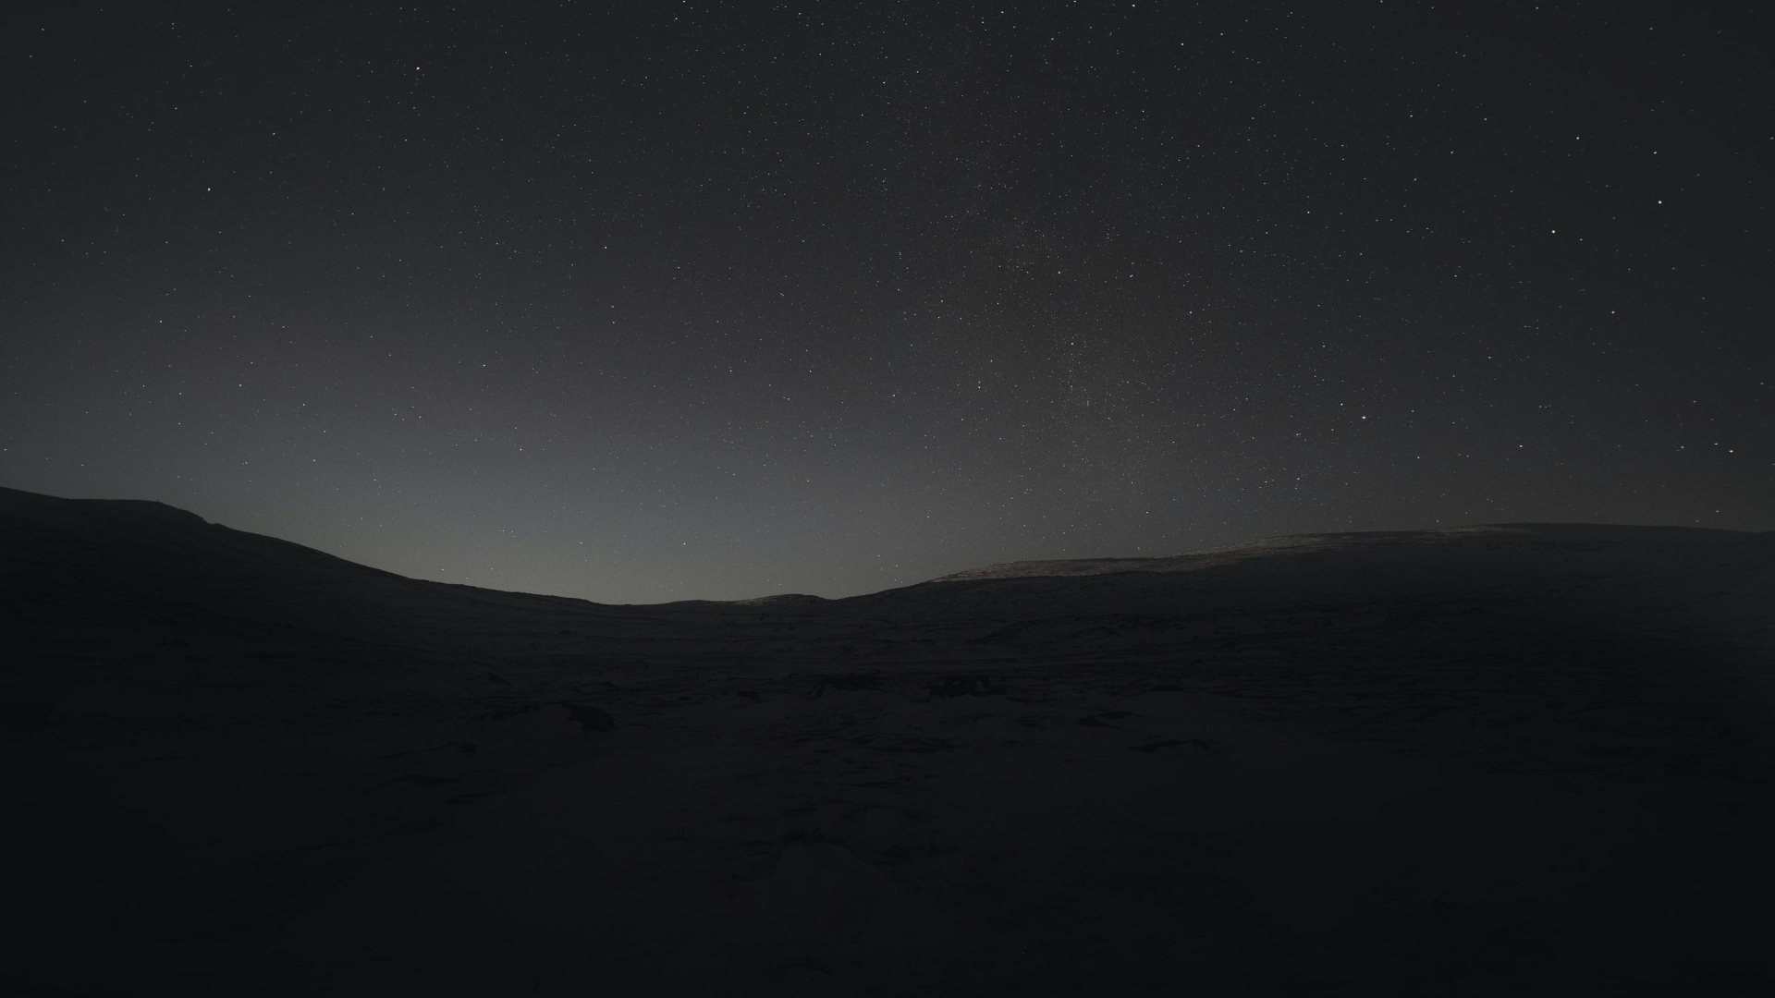
A gentle introduction
Linear Mixed-effects models
Luís Garcez
CEAUL – Centro de Estatística e Aplicações, Faculdade de Ciências, Universidade de Lisboa

Slide 2
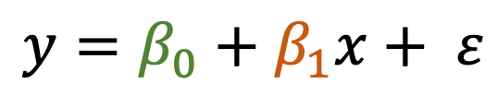
Linear Mixed-effects models
y
$$y=β_{0}+β_{1}x+ ε$$
Easy!
x
But…

Slide 3
Linear Mixed-effects models
y
$$y=β_{0}+β_{1}x+ ε$$
If sample observations are not independent, such as observations taken from the same student, from the same patient,
This model is not valid
x

Slide 4
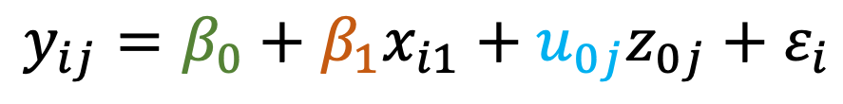
Linear Mixed-effects models
y
fixed effects
$$y_{ij}=β_{0}+β_{1}x_{i1}+u_{0j}z_{0j}+ε_{i}$$
For each observation i, it included in group of observations j
So, the solution is to “add” random effects, so each group of observations can be more correctly modelled.
x
(in this case a random intercept)

Slide 5
Background
Linear mixed models are an extension of simple linear models to allow both fixed and random effects, and are particularly used when there is non independence
This arises from hierarchical structure. For example, students could be sampled from classrooms, or patients from within doctors.
(esquema)

Slide 6
Modeling student achievement accounting for region and city
Portugal
Lisboa
Centro
Loures
Oeiras
Alcobaça
C. Branco
Cascais
Alverca
Coimbra
Algarve
Norte
Porto
Guimaraes
Faro
Olhão
Melgaço
Sagres
Braga
a student
a city
a region
a country

Slide 7
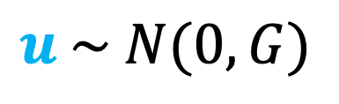
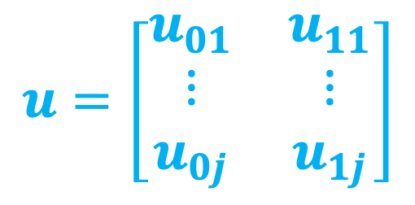
Linear Mixed-effects models
fixed effects
random intercept
random slope
y
$$y_{ij}=β_{0}+β_{1}x_{1i}+u_{0j}z_{0j}+u_{1j}z_{1j}+ε_{i}$$
For each observation i, it included in group of observations j
Beyond the random intercept, we can add random slopes.
$$u=\left[\begin{matrix}u_{01} & u_{11} \\ ⋮ & ⋮ \\ u_{0j} & u_{1j}\end{matrix}\right]$$
x
Because we directly estimated the fixed effects, including the fixed effect intercept, random effect complements are modeled as deviations from the fixed effect, so they have mean zero. The random effects are just deviations around the value in , which is the mean. So what is left to estimate is the variance… G is the variance-covariance matrix of the random effects
j groups of observations
$$u \sim N(0, G)$$

Slide 8
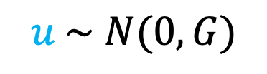
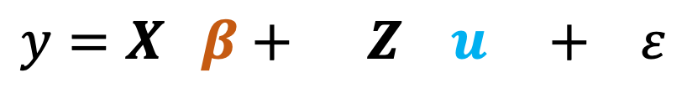
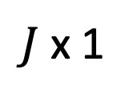
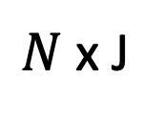
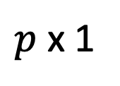
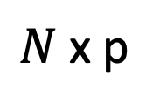
Matrix containing each variable value for each observation
Theory
Matrix with 0,1 to indicate the group of each observation
$N$ x p
$N$ x J
300 x 2
300 x 100
$$y=X β+ Z u + ε$$
$$u \sim N(0, G)$$
Matrix containing fixed effects magnitude for each group
$p$ x 1
$J$ x 1
Matrix containing random intercept magnitude for each group
2 x 1
100 x 1
Imagine 100 patients (groups of observations), with 3 observations each for Systolic Blood Pressure (y) and
it progresses with time (X₁) and Gender(X₂)

Slide 9
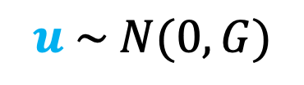
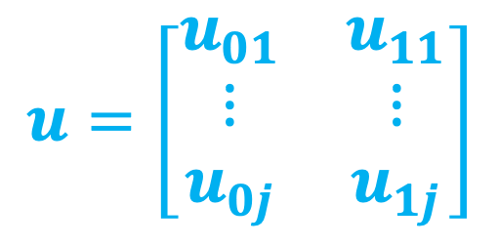
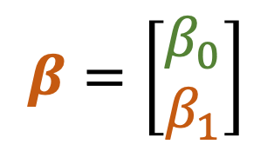
Linear Mixed-effects models
Because we directly estimated the fixed effects, including the fixed effect intercept, random effect complements are modeled as deviations from the fixed effect, so they have mean zero. The random effects are just deviations around the value in , which is the mean. So what is left to estimate is the variance…
G is the variance-covariance matrix of the random effects
fixed effects
random intercept
random slope
$$y_{ij}=β_{0}+β_{1}x_{1i}+u_{0j}z_{0j}+u_{1j}z_{1j}+ε_{i}$$
For each observation i, it included in group of observations j
Beyond the random intercept, we can add random slopes.
$$u=\left[\begin{matrix}u_{01} & u_{11} \\ ⋮ & ⋮ \\ u_{0j} & u_{1j}\end{matrix}\right]$$
$$β=\left[\begin{matrix}β_{0} \\ β_{1}\end{matrix}\right]$$
$$u \sim N(0, G)$$
j groups of observations

Slide 10
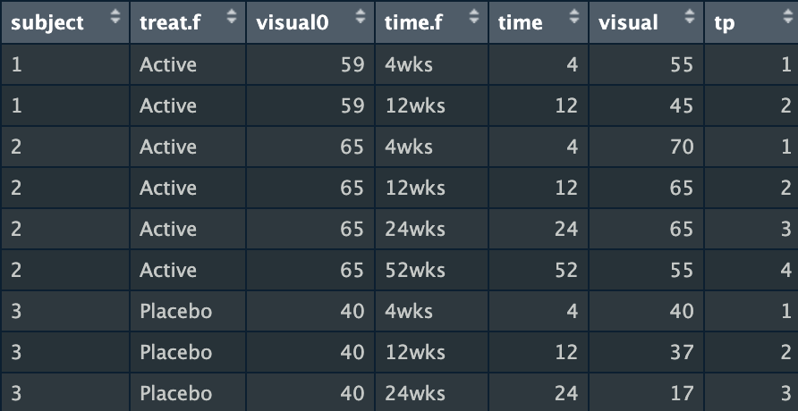
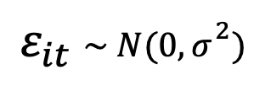
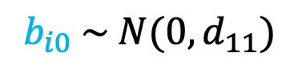
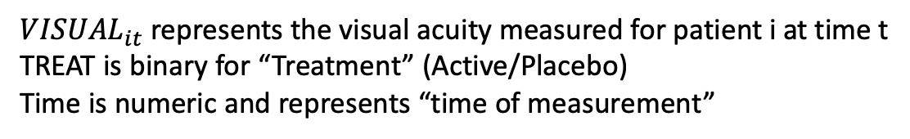
R example
R libraries:
nlme
lmer
Model visual acuity taking into account the correlation between measurements.
$${VISUAL}_{it}=β_{0}+β_{1}× {VISUAL0}_{i}+β_{2}×{TIME}_{it}+β_{3}×{TREAT}_{i}+β_{4}×{TREAT}_{i}×{TIME}_{it}+b_{i0}+ε_{it}$$
Subject specific intercept
${VISUAL}_{it}$ represents the visual acuity measured for patient i at time t
TREAT is binary for “Treatment” (Active/Placebo)
Time is numeric and represents “time of measurement”
$$b_{i0} \sim N(0, d_{11})$$
$$ε_{it} \sim N(0,σ^{2})$$
armd data

Slide 11
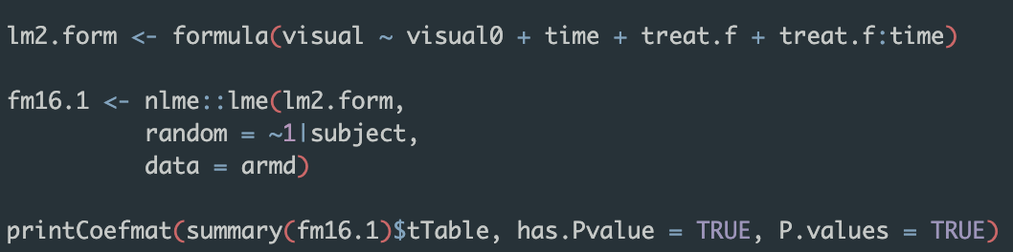
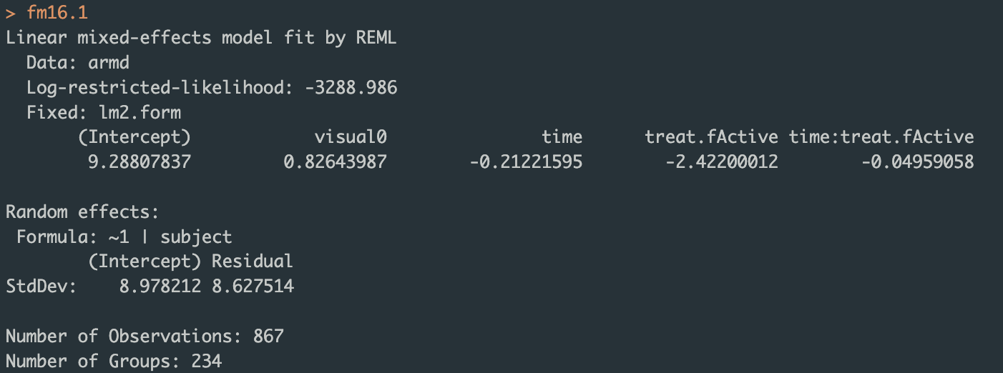
R example
Code:
8.97 is the random intercept SD
8.63 is the residuals SD
Output:

Slide 12
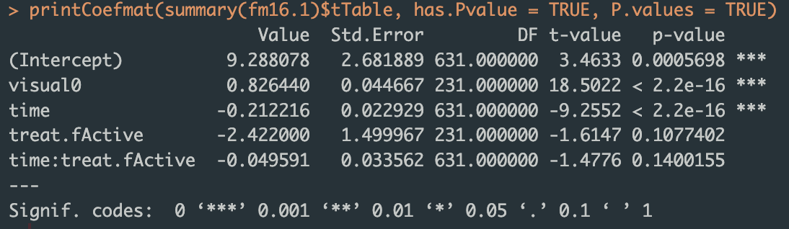
R example
Code:
Output:

Slide 13
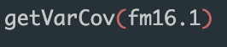
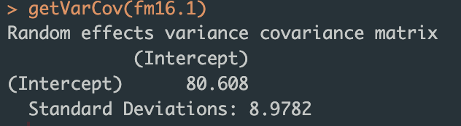
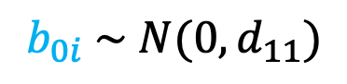
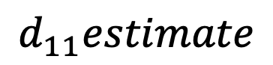
R example
Code:
$$b_{0i} \sim N(0, d_{11})$$
$$d_{11}estimate$$
Output:
The random effects are length 1, so the variance-covariance matrix is 1x1

Slide 14
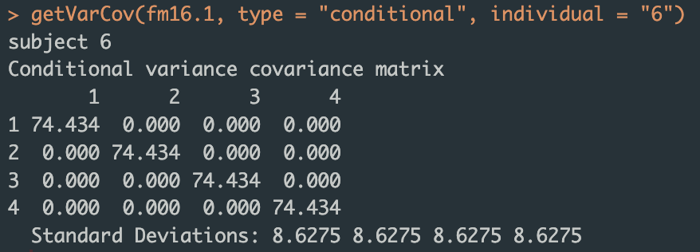
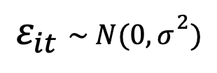
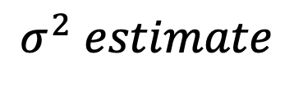
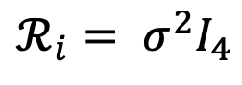
R example
Code:
$$σ^{2} estimate$$
$$ε_{it} \sim N(0,σ^{2})$$
$$ℛ_{i}= σ^{2}I_{4}$$
Output:
The number of residuals for each subject are the number of measurements made for each subject

Slide 15
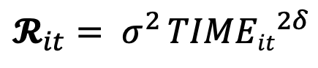
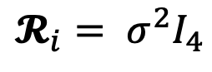
Residual Variance
$$𝓡_{i}= σ^{2}I_{4}$$
$$𝓡_{it}= σ^{2 }{TIMEit}^{2δ}$$
y
y
Residual variance has to be accounted in the model specification
x
x
Homogeneous residual variance
Heterogenous residual variance
The variability of measures increase with time

Slide 16
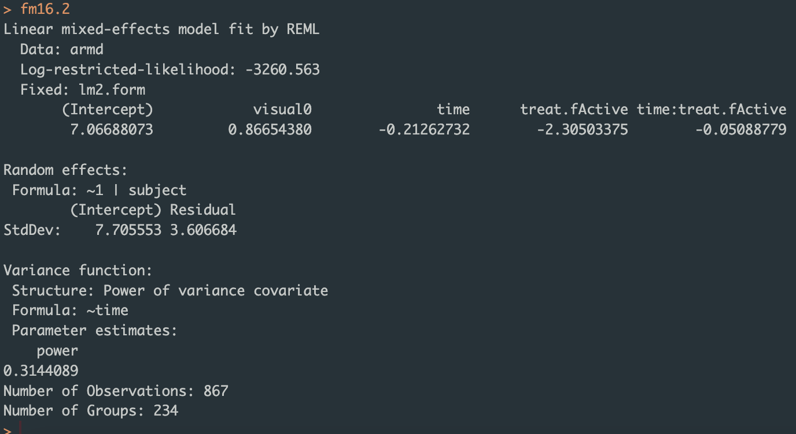
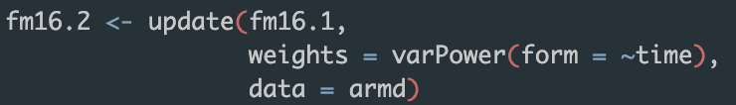
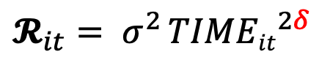
Residual Variance
$$𝓡_{it}= σ^{2 }{TIMEit}^{2δ}$$
y
Code:
Residual variance has to be accounted in the model specification
Output:
x
Heterogenous residual variance
The variability of measures increase with time

Slide 17
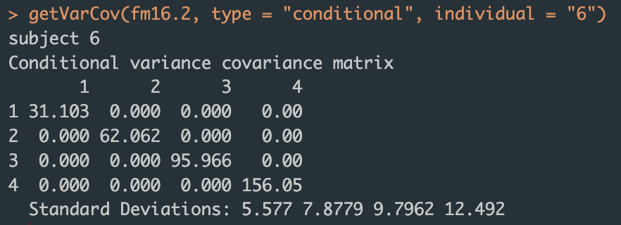
Residual Variance
$$𝓡_{it}= σ^{2 }{TIMEit}^{2δ}$$
y
Code:
Output:
Residual variance has to be accounted in the model specification
x
Heterogenous residual variance
The variability of measures increase with time

Slide 18
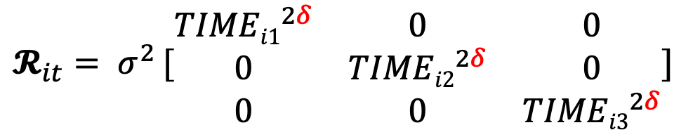
Residual Variance
$$𝓡_{it}= σ^{2 }{[\begin{matrix}{TIMEi1}^{2δ} & 0 & 0 \\ 0 & {TIMEi2}^{2δ} & 0 \\ 0 & 0 & {TIMEi3}^{2δ}\end{matrix}]}^{}$$
y
Code:
Output:
Residual variance has to be accounted in the model specification
x
Heterogenous residual variance
The variability of measures increase with time

Slide 19
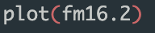
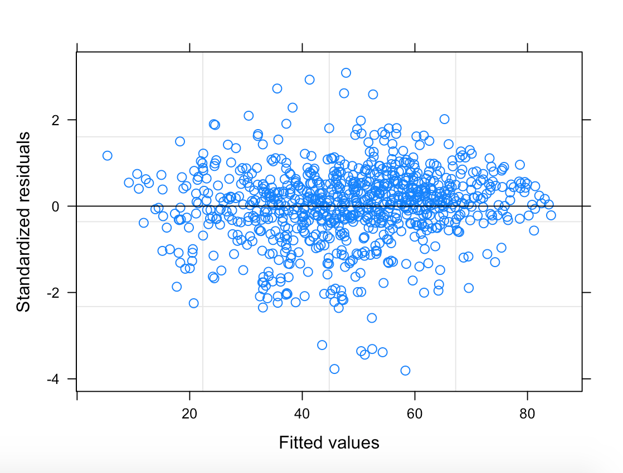
Diagnostic plots
Pearson residuals
Residuos pearson formula

Slide 20
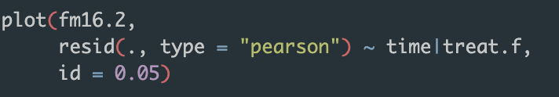
Diagnostic plots
Pearson residuals per treatment/time

Slide 21
Diagnostic plots
Test residual normality per time

Slide 22
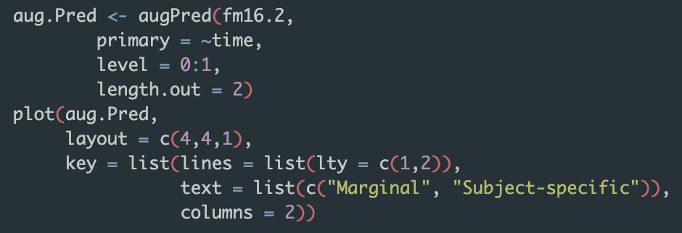
Diagnostic plots

Slide 23
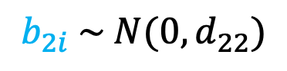
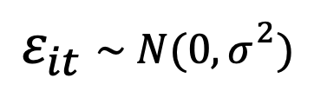
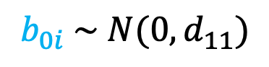
R example
R libraries:
nlme
lmer
Adding a random slope…
$${VISUAL}_{it}=β_{0}+β_{1}× {VISUAL0}_{i}+β_{2}×{TIME}_{it}+β_{3}×{TREAT}_{i}+β_{4}×{TREAT}_{i}×{TIME}_{it}+b_{0i}+b_{2i}×{TIME}_{it}+ε_{it}$$
Subject specific intercept
Subject specific slope
${VISUAL}_{it}$ represents the visual acuity measured for patient i at time t
$$b_{0i} \sim N(0, d_{11})$$
$$b_{2i} \sim N(0, d_{22})$$
$$ε_{it} \sim N(0,σ^{2})$$
armd data

Slide 24
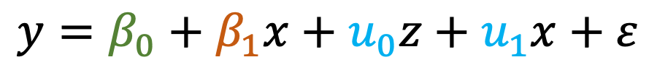
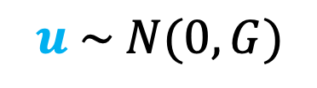
Linear Mixed-effects models
y
fixed effects
random intercept
random slope
$$y=β_{0}+β_{1}x+u_{0}z+u_{1}x+ε$$
Beyond the random intercept, we can add random slopes.
x
Because we directly estimated the fixed effects, including the fixed effect intercept, random effect complements are modeled as deviations from the fixed effect, so they have mean zero. The random effects are just deviations around the value in , which is the mean. So what is left to estimate is the variance… G is the variance-covariance matrix of the random effects
$$u \sim N(0, G)$$

Slide 25
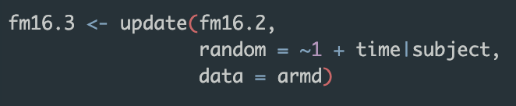
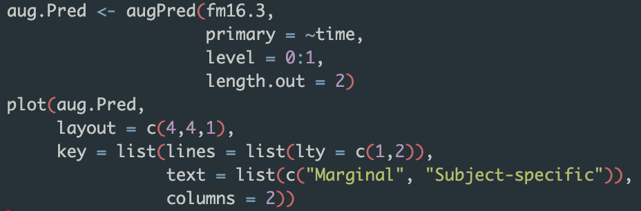
Diagnostic plots
Model specification:
Vizualization:

Slide 26
Diagnostic plots
With random intercept
With random intercept AND random slopes

Slide 27
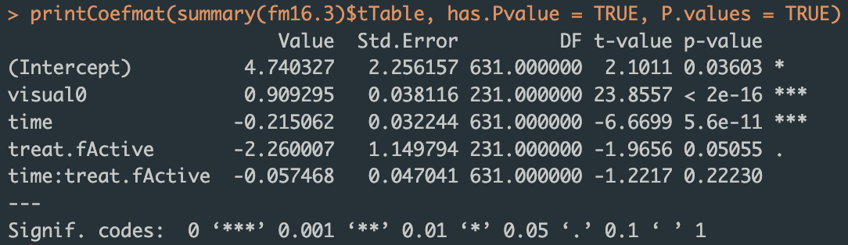
Diagnostic plots
Model specification:
Coefficients:

Slide 28
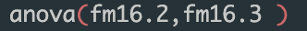
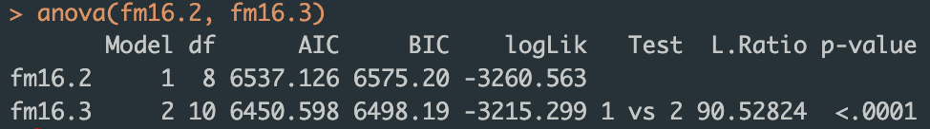

Diagnostic plots
Are random slopes needed?
Likelihood Ratio test
Model with random intercept only
Model with random intercept + random slope
$$H_{0}:fm16.2=fm16.3$$

Slide 29
Bibliography
Andrzej Galecki and Tomasz Burzykowski. 2013. Linear Mixed-Effects Models Using R: A Step-by-Step Approach. Springer Publishing Company, Incorporated.

Slide 30
Thank you!
luis.garcez@alunos.ciencias.ulisboa.pt
All code and presentation available at: https://github.com/luisgarcez11

